Slide 1
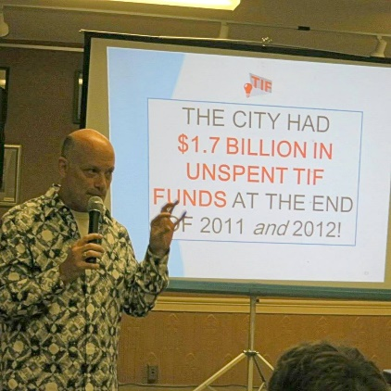
“TIFs & Orland Park”
October 30, 2024 Tom Tresser
Notes:
Version: 10/27/24
Music: “Would I Lie To You?” – Annie Lennox & the Eurythmics -> https://www.youtube.com/watch?v=Uhpu2N4rQZM

Slide 2
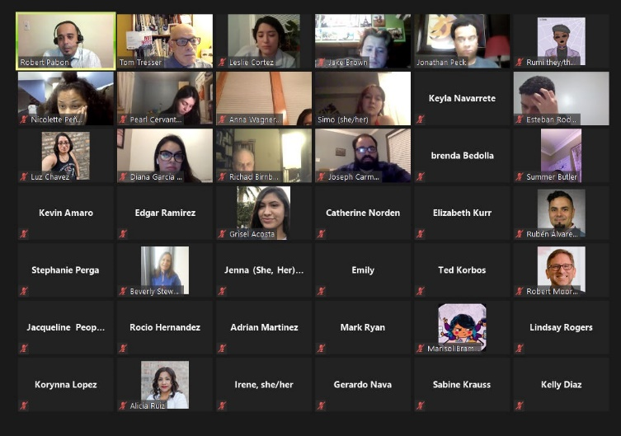
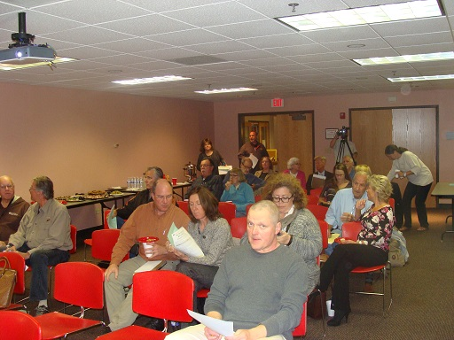
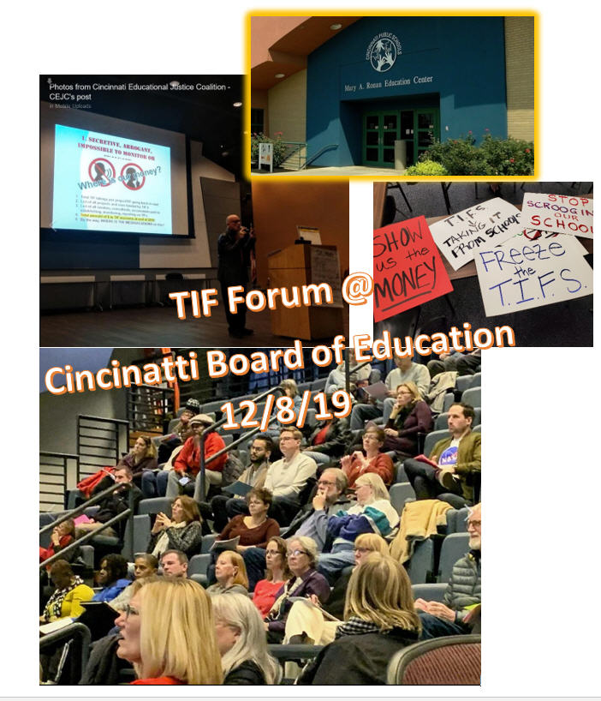
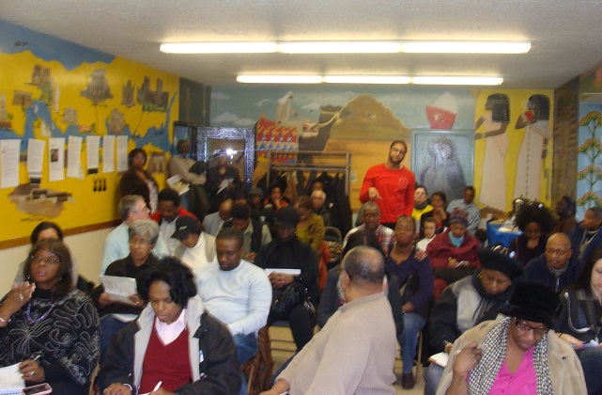
We’ve done 240+ public events since Feb 2013!
Berwyn
Woodstock
20th Ward
Notes:
Bring us to YOUR community! http://www.tifreports.com/tif-organizing-services

Slide 3
The TIF Illumination Project
Go to www.tifreports.com for video primer and other background info on how TIFs work…
290,000 people Illuminated since 2013!
Notes:
Check out http://www.tifreports.com – Most content behind paywall.

Slide 4
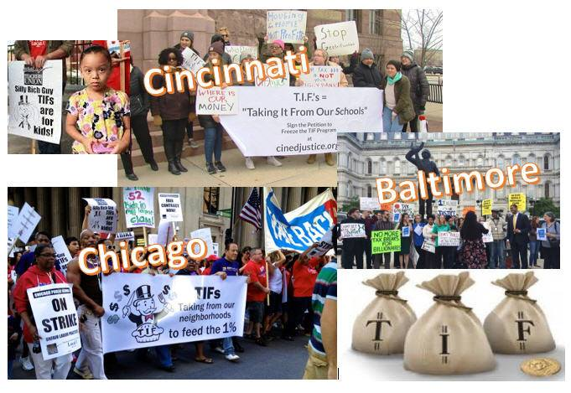

Slide 5
What are TIFs?
Created by municipality (IL state law)
Designed to subsidize some business project in “blighted” or under-served area
“But for” test – only for projects market CAN NOT support
Captures “incremental” property taxes ABOVE base when district was created
Only for hard costs
Lasts 23 years
Supposed to be spent where collected
Property taxes!

Slide 6
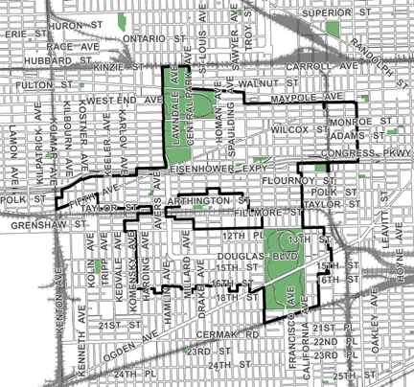
What are TIFs?
Say there are 1,000 properties in this TIF…
…then this $1,000 is called the “Base.”
…and say that these properties are generating $1,000 in property taxes as the TIF starts…
The Midwest TIF – 24th Ward (created in 2000)

Slide 7
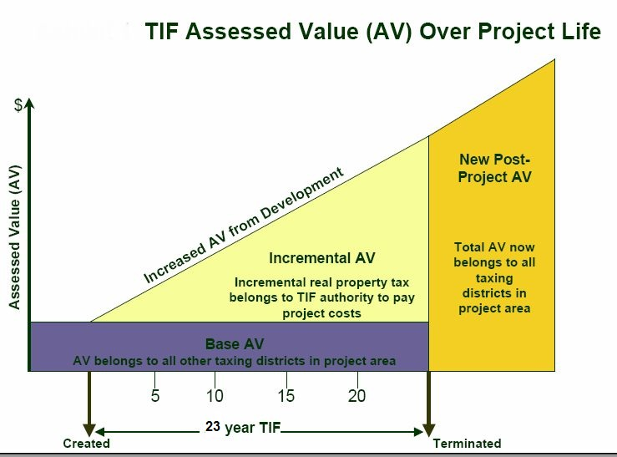
How Do TIFs Work?
When the TIF is created, the city tallies up all the property taxes generated by district in that year (called the "base" amount). After that, all property tax increases above the base (the "increment") are channeled to the TIF district.
The property taxes collected from properties inside the district BEFORE the district was created that go to units of government stays FLAT for the life of the TIF (23 years).
$1,000 from example

Slide 8
How Do TIFs Work?
THIS MONEY GOES TO THE MAYOR.
IT IS “OFF THE BOOKS”
THIS MONEY IS USED FOR UNITS OF LOCAL GOVERNMENT. IT IS “ON THE BOOKS”
$1,000 from example

Slide 9
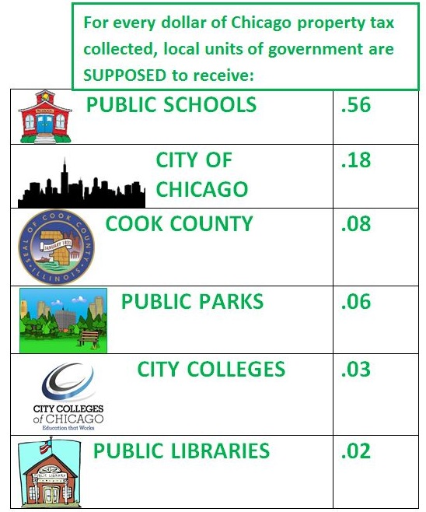
Money From TIFs Taken From?
The “Base”
$1,000 from example

Slide 10
What are TIFs?
Under state law, areas proposed for TIF designation must possess numerous blighting factors to be eligible:
Age
Obsolescence
Code violations
Excessive vacancies
Overcrowding of facilities

Slide 11
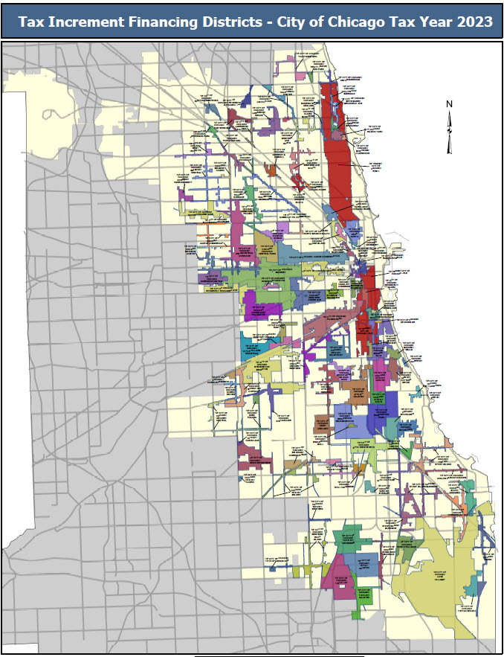
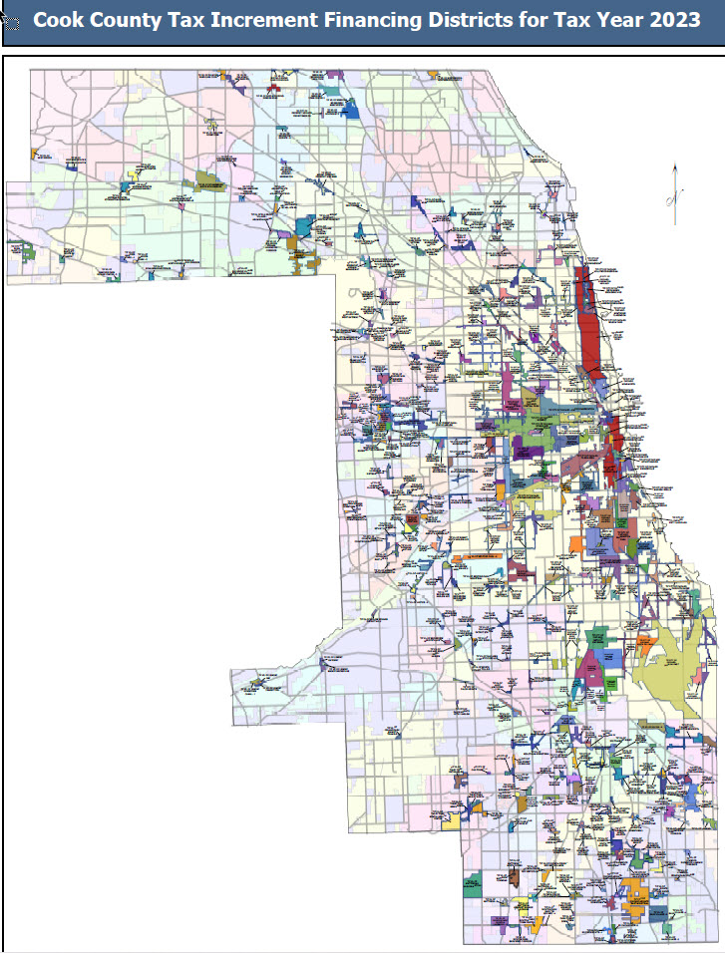
Where are TIFs?
2023 Chicago = 124 Suburbs = 309
Cook County = 433
34% of ALL of Chicago is in
a TIF!
98 municipalities
Notes:
Chicago: https://www.chicago.gov/city/en/depts/dcd/supp_info/tif-district-annual-reports-2004-present.html
Cook County: https://www.cookcountyclerkil.gov/property-taxes/tifs-tax-increment-financing/tif-reports

Slide 12
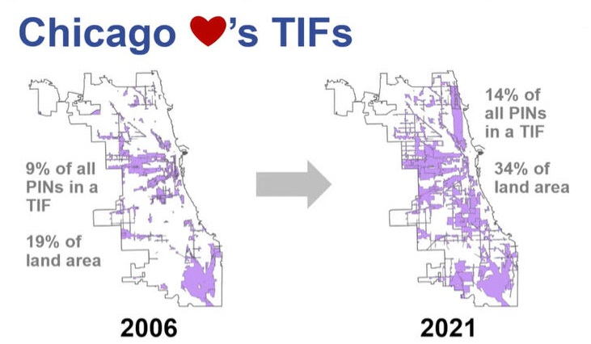
Where are TIFs?
Source: Cook County Assessor’s Office – 1/17/23 presentation

Slide 13
Chicago TIFs have
RUN AMOK!
124 active TIFs in 2023
$1.2 Billion removed in 2023
$409.7 million spent in 2023
$12.4 Billion removed since 1986

Slide 14
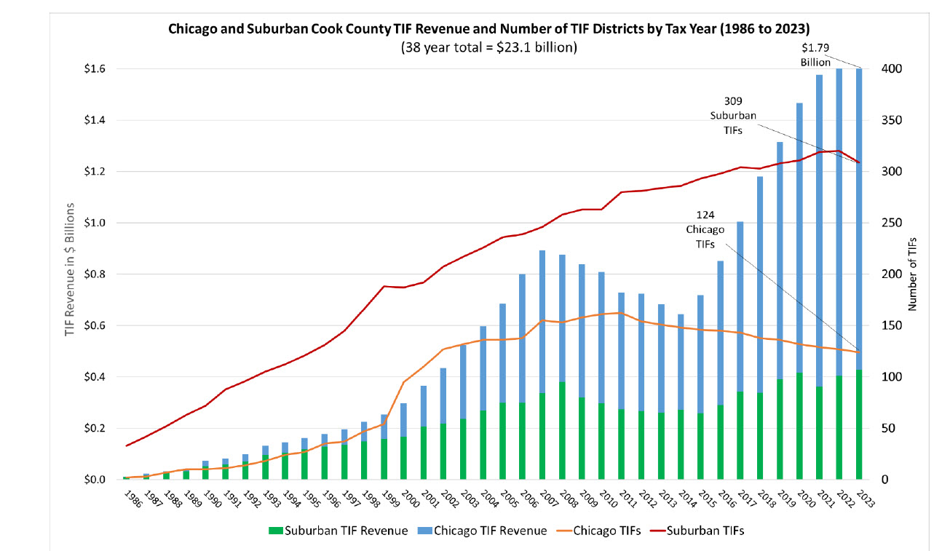
Cook county TIFs HAVE RUN AMOK!
Notes:
Total TIF property tax removal in 2023 for Cook County was almost $1.8 billion. In the past 38 years TIFs have removed a staggering $23.1 billion from public use in Cook County! Source: Cook County Clerk -> https://www.cookcountyclerkil.gov/sites/default/files/pdfs/2023%20TIF%20Report.pdf

Slide 15
CHICAGO HAD $3 BILLION IN UNSPENT TIF FUNDS AT THE END OF 2023!
Mr. TIF
Notes:
Biggest #, greatest service we reveal this # every year.

Slide 16
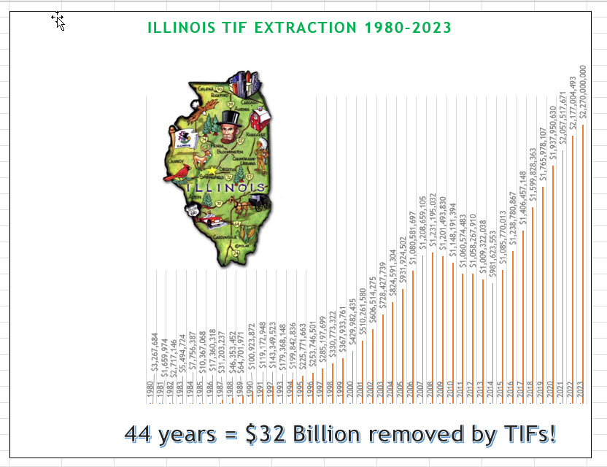
$32 BILLION TO DATE!
1,453 TIFs x 534 municipalities!
$2.3 BILLION REMOVED IN 2023

Slide 17
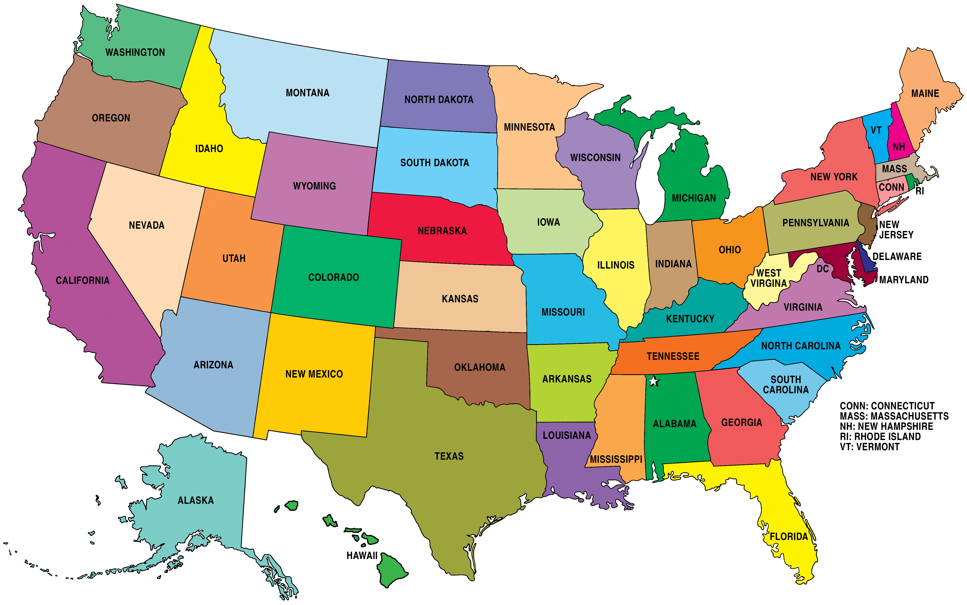
Estimated 40,000+ TIFs extract $40 BILLION/year!
Notes:
That’s $20 BILLION extracted, taken offline ANNUALLY, from US public education funding via property taxes!

Slide 18
A few problems…

Slide 19
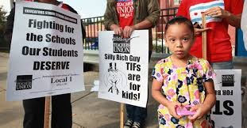
TIFs starve local government.
We care about our property tax dollars,
so we want to track how they are used and abused…

Slide 20
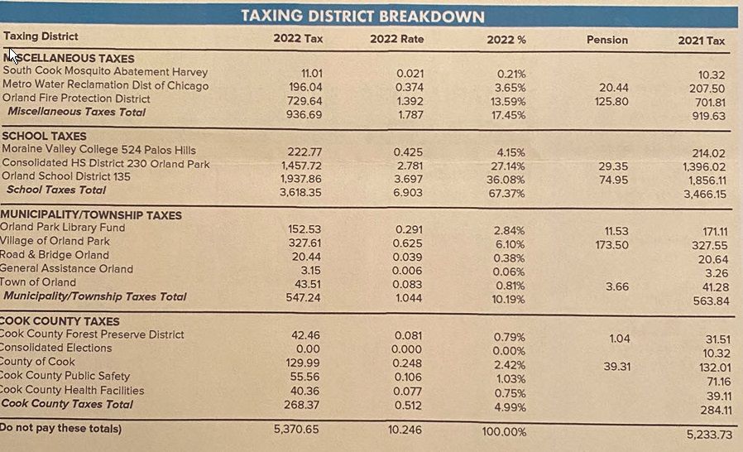
This is how property taxes are SUPPOSED to be distributed in Orland Park…
Notes:
Remember this # - 67% of your property tax dollar here is SUPPOSED to go to fund local public education.

Slide 21
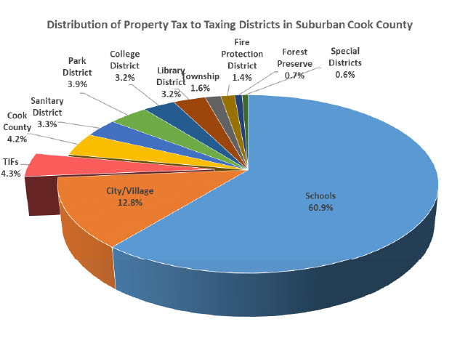
In 2023 TIFs removed 4.3% of all suburban Cook property taxes collected!
Source: Cook County Clerk

Slide 22
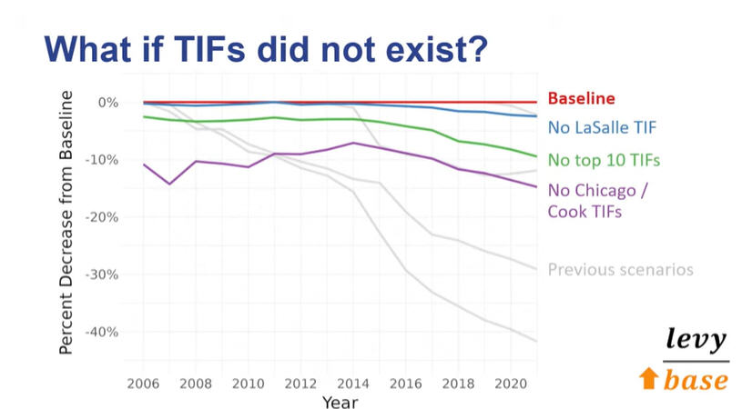
TIFs raise our taxes.
Removing TIFs = 15% DECREASE in property taxes!
Source: Cook County Assessor’s Office – 1/17/23 presentation

Slide 23
TIFs raise our taxes.
Source: Cook County Assessor’s Office – 1/17/23 presentation
Notes:
Based on a real 2-flat in Pilsen on 18th Street – 2021 market value = $530,000 & 2021 tax bill = $10,658

Slide 24
Definition of “blight” is meaningless.

Slide 25
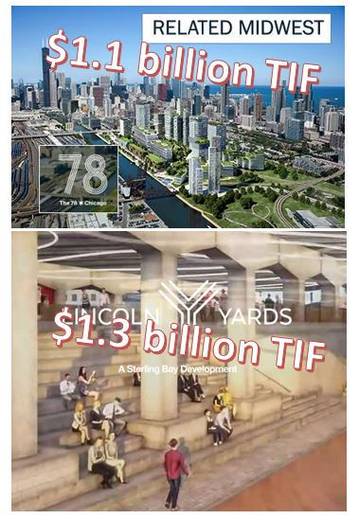
$800 million in finance fees!

Slide 26
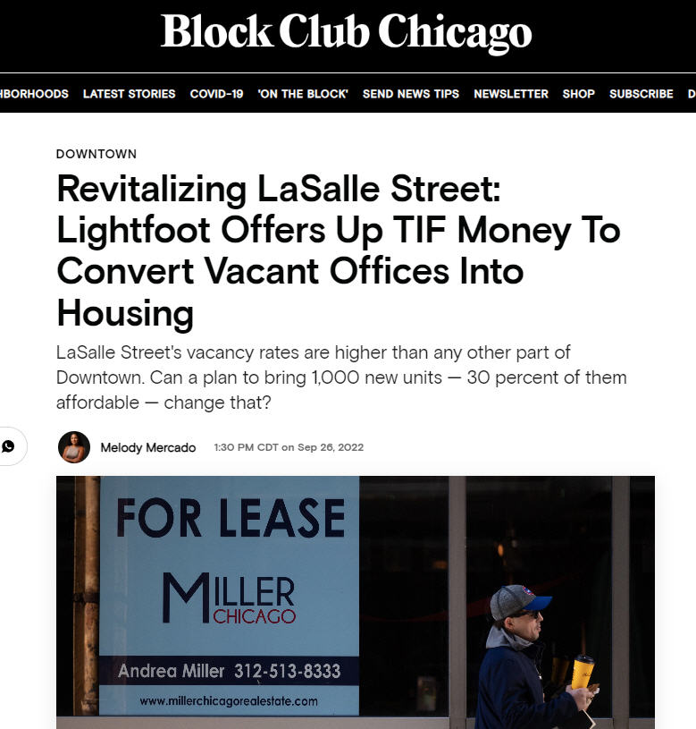
Notes:
Mayor Lightfoot proposing to use TIFs again in heart of Chicago’s Financial District!
https://blockclubchicago.org/2022/09/26/lightfoot-plans-to-revitalize-lasalle-street-by-offering-up-tif-money-to-convert-vacant-offices-into-housing

Slide 27
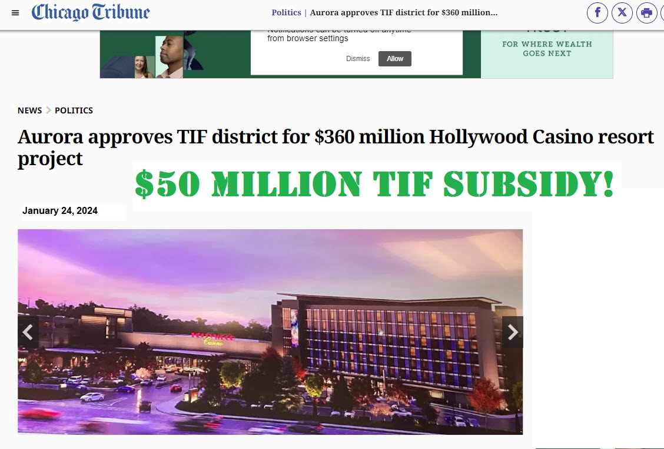
Notes:
https://www.chicagotribune.com/2024/01/24/aurora-approves-tif-district-for-360-million-hollywood-casino-resort-project

Slide 28
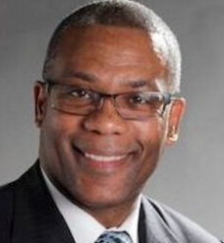
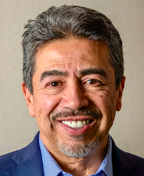
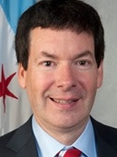
Many, many instances of Aldermen receiving cash from TIF project owners/developers.
TIFs corrupt.
Indicted
Carrie Austin, 34th Ward - $14,650 – 2 projects/$22.9 million TIF funds
Walter Burnett, 27th Ward - $3,000 – 1 project/$7 million TIF funds
Danny Solis, 25th Ward - $64,100 – 1 project/$9 million TIF funds
Wore wire for FBI for 2 years
Brian Hopkins, 2nd Ward - $6,000 – 1 project/$1.3 billion TIF funds (Lincoln Yards)

Slide 29
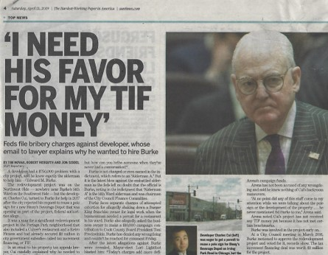
Convicted, Now serving 2 year
sentence!
Notes:
37 Chicago Aldermen indicted for corruption since 1973!

Slide 30
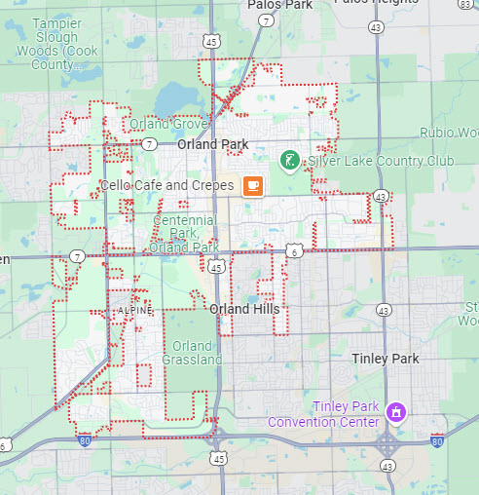
What’s up with TIFs?

Slide 31
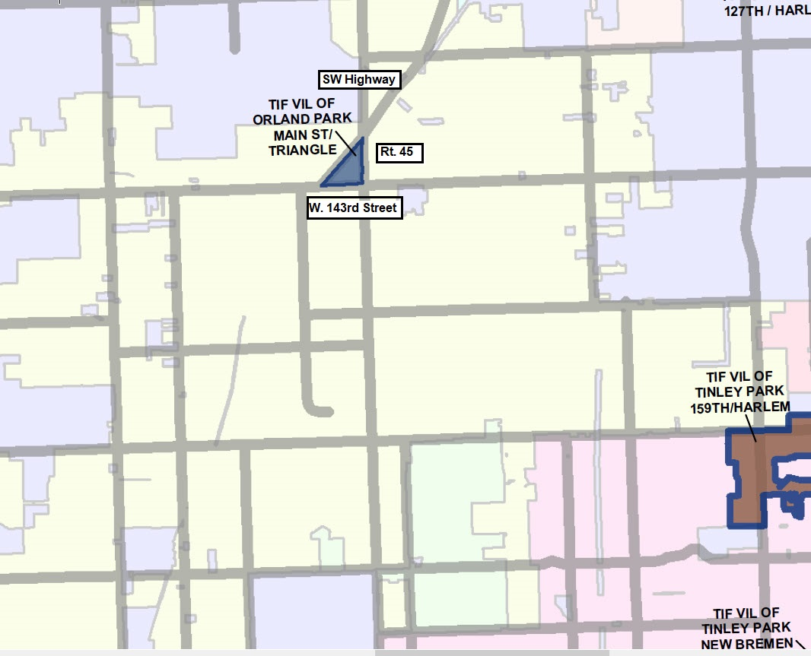
Main Street Triangle TIF

Slide 32
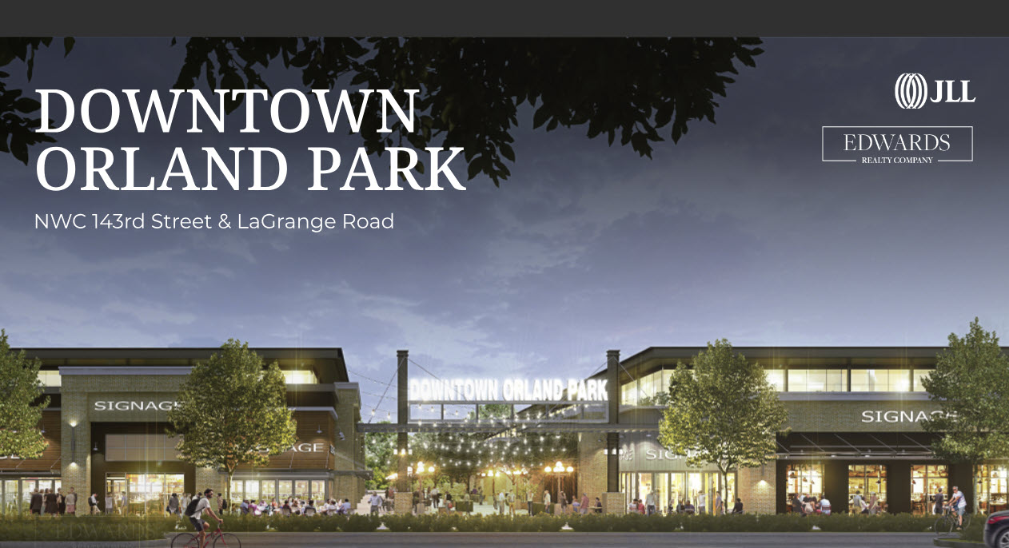
Notes:
https://www.orlandpark.org/departments/development-services/downtown-development
“In 2004, the Village of Orland Park undertook an ambitious effort to develop an area that meets the Village’s long standing vision of creating a pedestrian-friendly downtown environment for Orland Park. Having invested approximately $150 million within the Triangle in public/private partnerships, public investments, private investments, land acquisition, construction of public infrastructure and amenities, environmental remediation, and roadway intersection improvements, the project remains incomplete. Seeking to finally bring home the Village’s long standing vision for this area, at the May 2, 2022 Village Board meeting, the Village Board approved the Conceptual Master Development Plan for Downtown Orland Park. After receiving two proposals for a master developer, the Village of Orland Park began to negotiate a Master Development Agreement with Edwards Realty to develop the remaining 9.15 acres of land in the Main Street Triangle at the Northwest corner of 143rd Street and LaGrange Road. This area, also known as Downtown Orland Park, is currently a TIF District.”

Slide 33
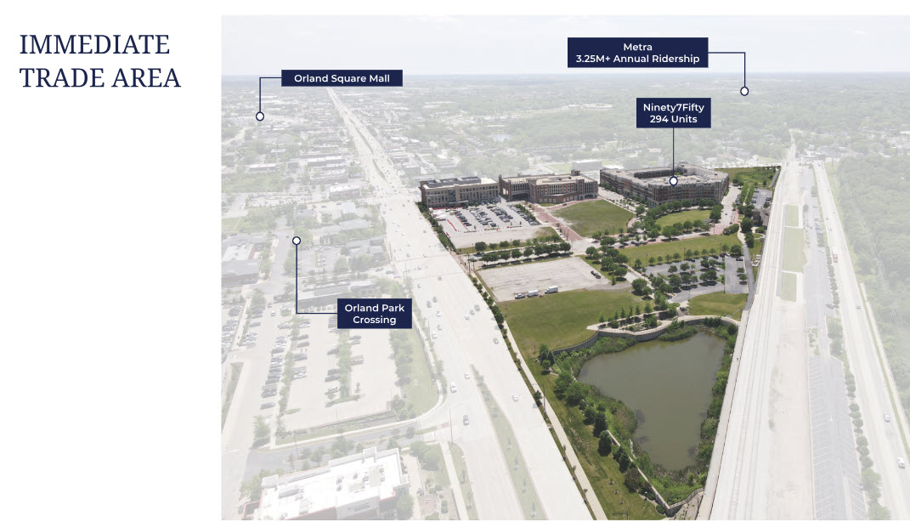
Notes:
https://www.orlandpark.org/departments/development-services/downtown-development

Slide 34
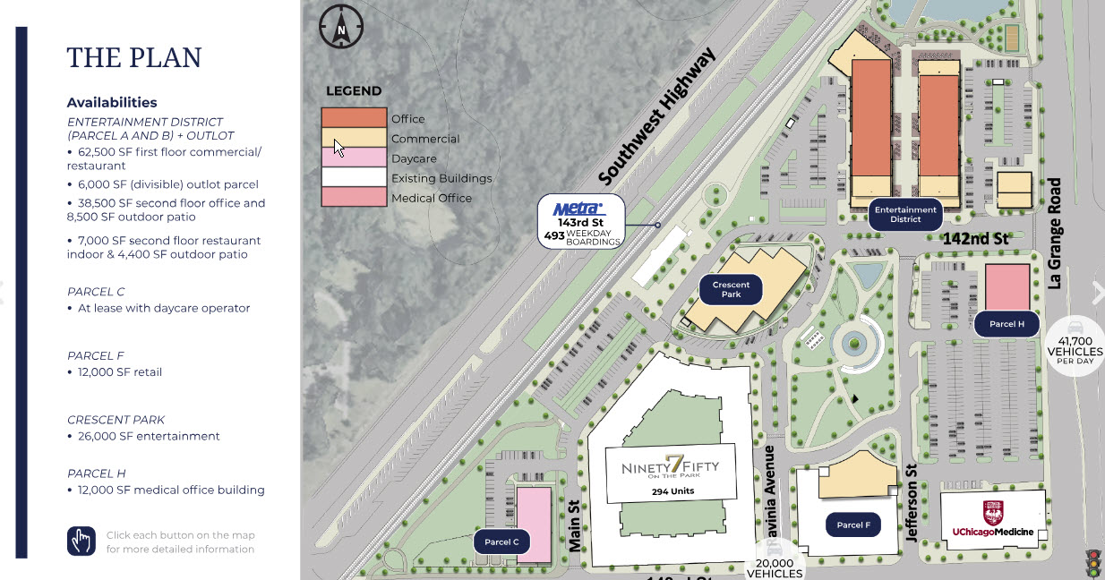
Notes:
https://www.orlandpark.org/departments/development-services/downtown-development

Slide 35
Main Street Triangle TIF
Created in 2004, will expire in 2027
Property taxes removed in 2023 = $1,527,742
Property taxes removed in 2022 = $1,871,395
Total removed 2004-2023 = $15,619,961
$ in from “Private Sources” in 2020 = $770,000
Expenses in 2020 = $1,762,967 ($1.2 million for debt service)
Balance at end of 2020 (latest annual report) = ($27,401,011)

Slide 36
Main Street Triangle TIF
No TIF annual reports for 2021, 2022, 2023
Reports not available anywhere! BUT I have the 2020 Annual Report…
2020 Report shows $65,705,256 in Bond Proceeds and total $31,348,534 from Private Sources (seems to be 4 bond issues)
Also has item “Adl Amount Deposited in Special Tax Allocation Fund” = $1,974,8000

Slide 37
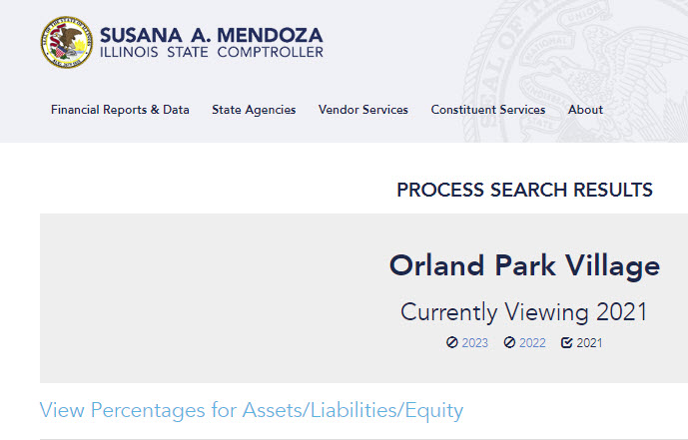
Annual Audits
Notes:
https://illinoiscomptroller.gov/constituent-services/local-government/local-government-warehouse/processsearchresults

Slide 38
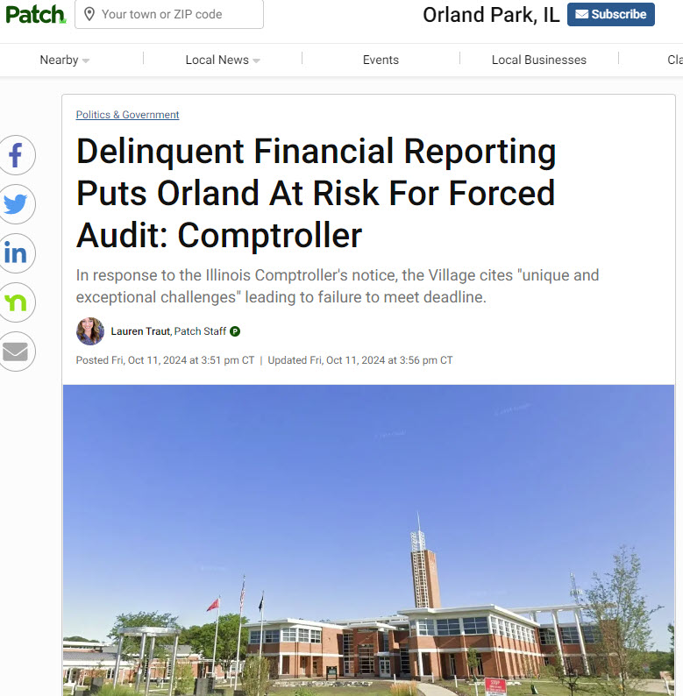
Notes:
https://patch.com/illinois/orlandpark/delinquent-financial-reporting-puts-orland-risk-forced-audit

Slide 39
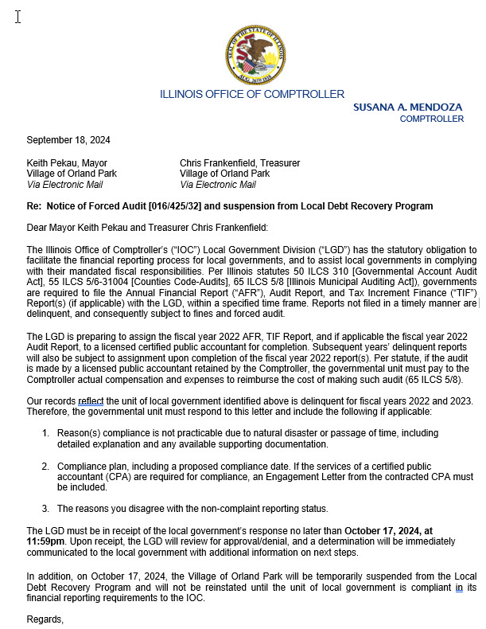

Slide 40
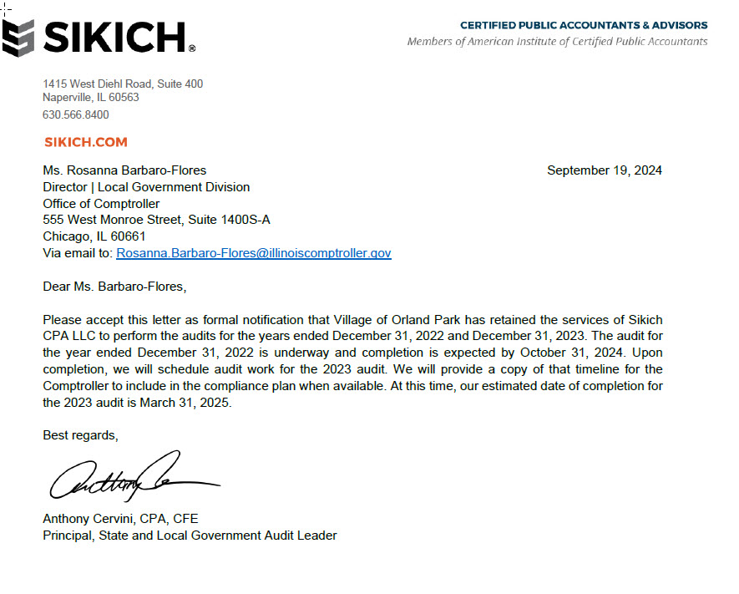

Slide 41
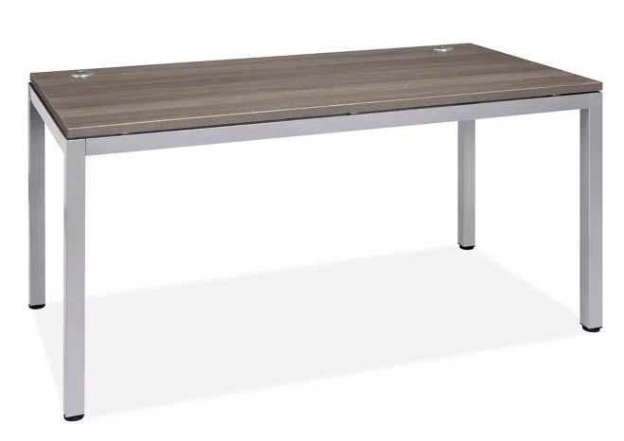
What is on the TIF table?

Slide 42
October 15, 2024
The former Andrew Corp. headquarters and factory in Orland Park, shown in this February 2020 photo, may be designated as a TIF district.

Slide 43
October 15, 2024
Orland Park officials are considering the creation of three new tax increment financing districts in an effort to spur redevelopment on properties including the former Andrew Corp. headquarters and factory, according to village documents and Mayor Keith Pekau.
For now, Orland Park and developers are studying the issue and hired a consultant to determine if the three sites are eligible for TIF designation under state law. Along with the long-vacant Andrew Corp. property, 10500 W. 153rd St., the village is studying possible TIFs to take in the closed Petey’s II restaurant at the southwest corner of La Grange Road and 159th Street, and the former site of Terry’s Lincoln-Mercury at the southwest corner of 143rd Street and John Humphrey Drive, Pekau said.
The Village Board voted in August to commit to working on possible redevelopment projects at the sites, and developers have already put money into escrow funds to pay some of the costs.

Slide 44
JD Real Estate Orland Park Lake Ventures
Notes:
https://therealdeal.com/chicago/2024/10/15/developers-want-tifs-for-suburban-chicago-vacant-tracts

Slide 45
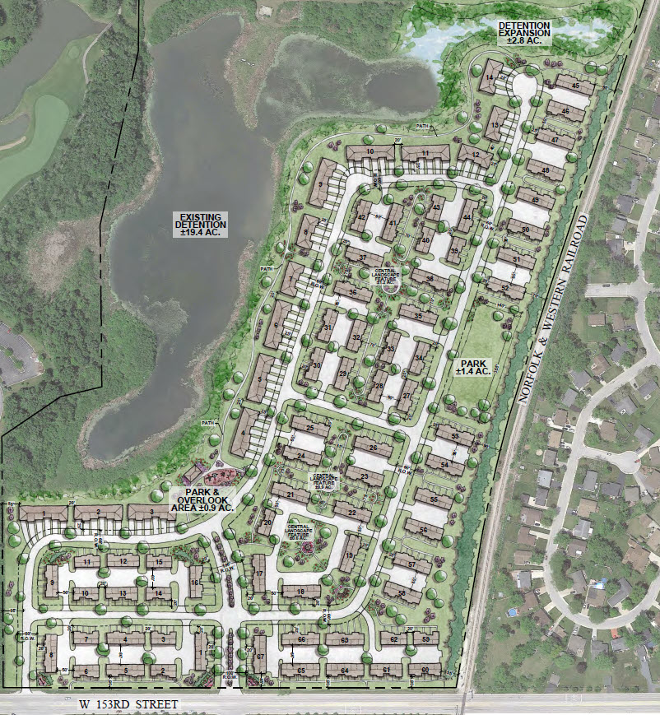
W. 153rd Street
No real details for other 2 TIFs – “mixed use – retail and residential” was all I could find in Escrow Agreement documents.

Slide 46
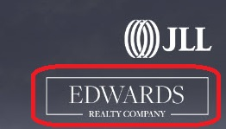
$5,000 to Keith For Mayor 9/21
$5,000 to Keith For Mayor 3/24
$17,800 in tasty campaign treats for the Mayor – the taxpayers of Orland Park will pay for the tricks!
$7,800 to Keith for Mayor -
8 donations, 10/17-> 7/23
Notes:
Source Illinois Sunshine database = https://illinoissunshine.org

Slide 47
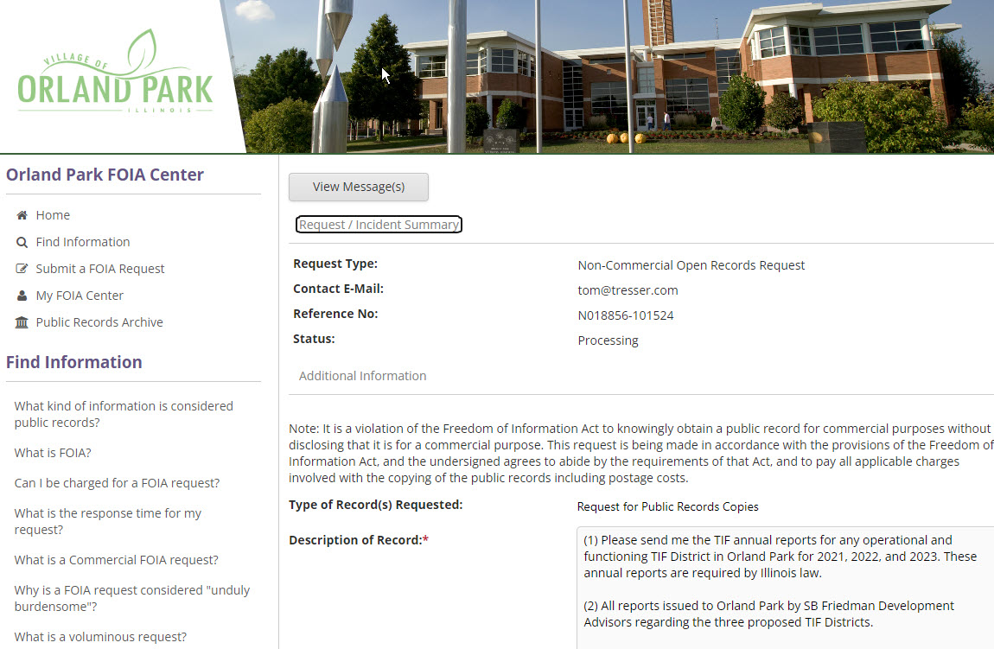
Notes:
https://orlandparkil.mycusthelp.com/WEBAPP/_rs/(S(s4nbs5nfeahiv5inc5rwb2hn))/RequestEdit.aspx?sSessionID=69246248188UPVHDEXOLVGDGWDQRBHDQETGHJOUP&rid=18856

Slide 48
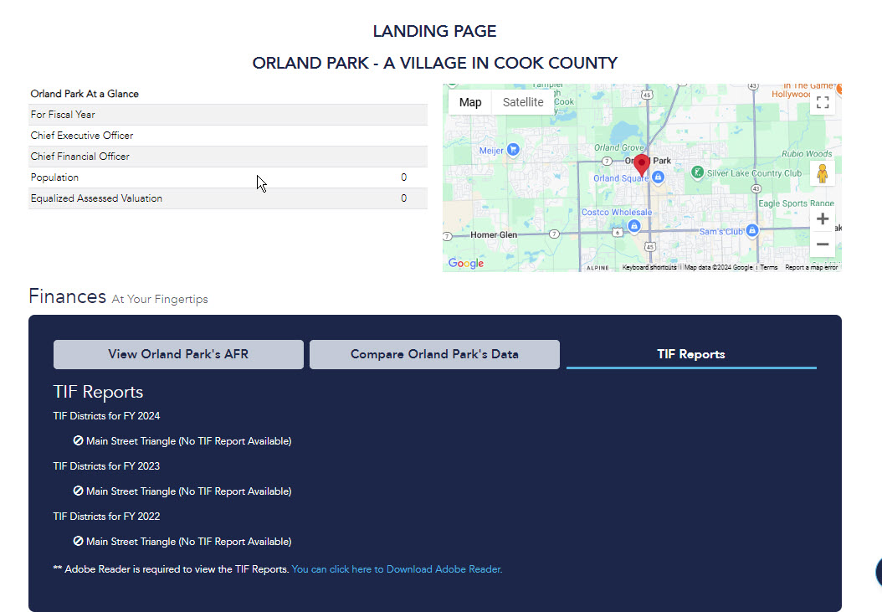
You can’t find ANY TIF Annual Report from Orland Park!

Slide 49
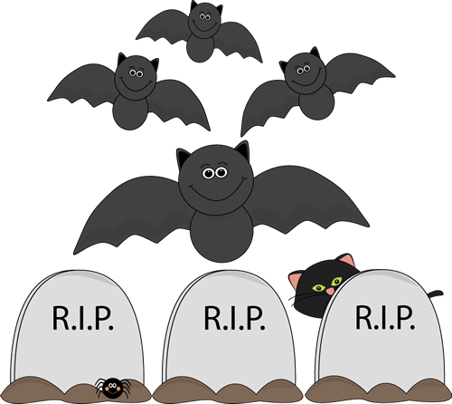
Creating three new TIFs in a town that has not been reporting its required financial data for THREE years is scary!

